Slide 1
Full Stack Web Development
JavaScript / Learning Ajax

Slide 2
What Is AJAX?
AJAX stands for Asynchronous JavaScript & XML
It is used to update specific parts of a webpage without reloading the whole page
Works by exchanging small amounts of data with the server behind the scenes
Gmail, Google Maps, YouTube, Facebook all use Ajax

Slide 3
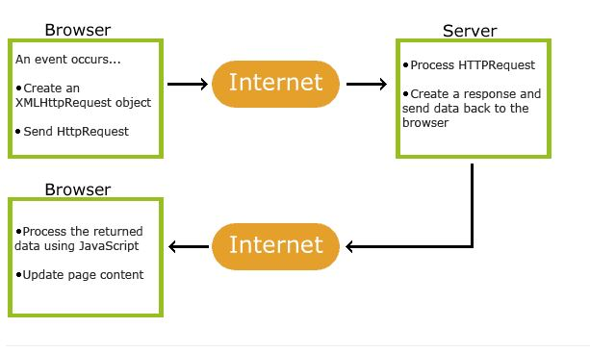
How AJAX Works

Slide 4
XMLHttpRequest Object
An API that provides client functionality for transferring data between a client and server
Easy way to retrieve data from a URL without having to do a full page refresh
XMLHttpRequest is not limited to XML. It also can use JSON, file and FTP.

Slide 5
XMLHttpRequest Properties
onreadystatechange
readyState
response
responseText
responseType
responseURL
responseXML
status
statusText
timeout
ontimeout
upload
withCredentials

Slide 6
XMLHttpRequest Methods
abort()
getAllResponseHeaders()
getResponseHeader()
open()
overrideMimeType()
send()
setRequestHeader()

Slide 7
Creating The Object
var xhttp; if (window.XMLHttpRequest) { xhttp = new XMLHttpRequest(); } else { // code for IE6, IE5 xhttp = new ActiveXObject("Microsoft.XMLHTTP"); }

Slide 8
Sending a Request
xhttp.open("GET", “somefile.txt", true); xhttp.send();

Slide 9
GET / POST
GET is faster but should only be used to request data from a server
POST is usually used to send a large amount of data to the server or send user input
A good example for GET would be a search form and POST would be a user registration form

Slide 10
Getting A Response
xmlDoc = xhttp.responseXML; txt = ""; x = xmlDoc.getElementsByTagName("ARTIST"); for (i = 0; i < x.length; i++) { txt += x[i].childNodes[0].nodeValue + "<br>"; } document.getElementById("demo").innerHTML = txt;

Slide 11
Events
onReadyState – Stores a function to be called everytime the readyState changes
readyState - Holds the status of the XMLHttpRequest object (0 - 4)
0: request not initialized 1: server connection established 2: request received 3: processing request 4: request finished and response is ready
Status – Request status
200: OK
404: Page Not Found

Slide 12


